Slide 1
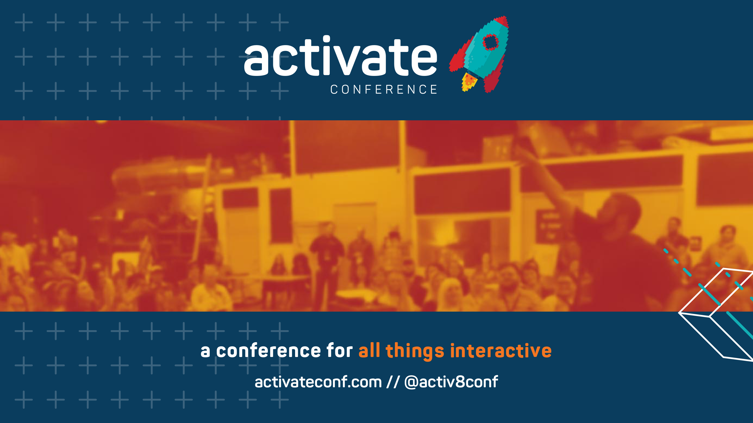
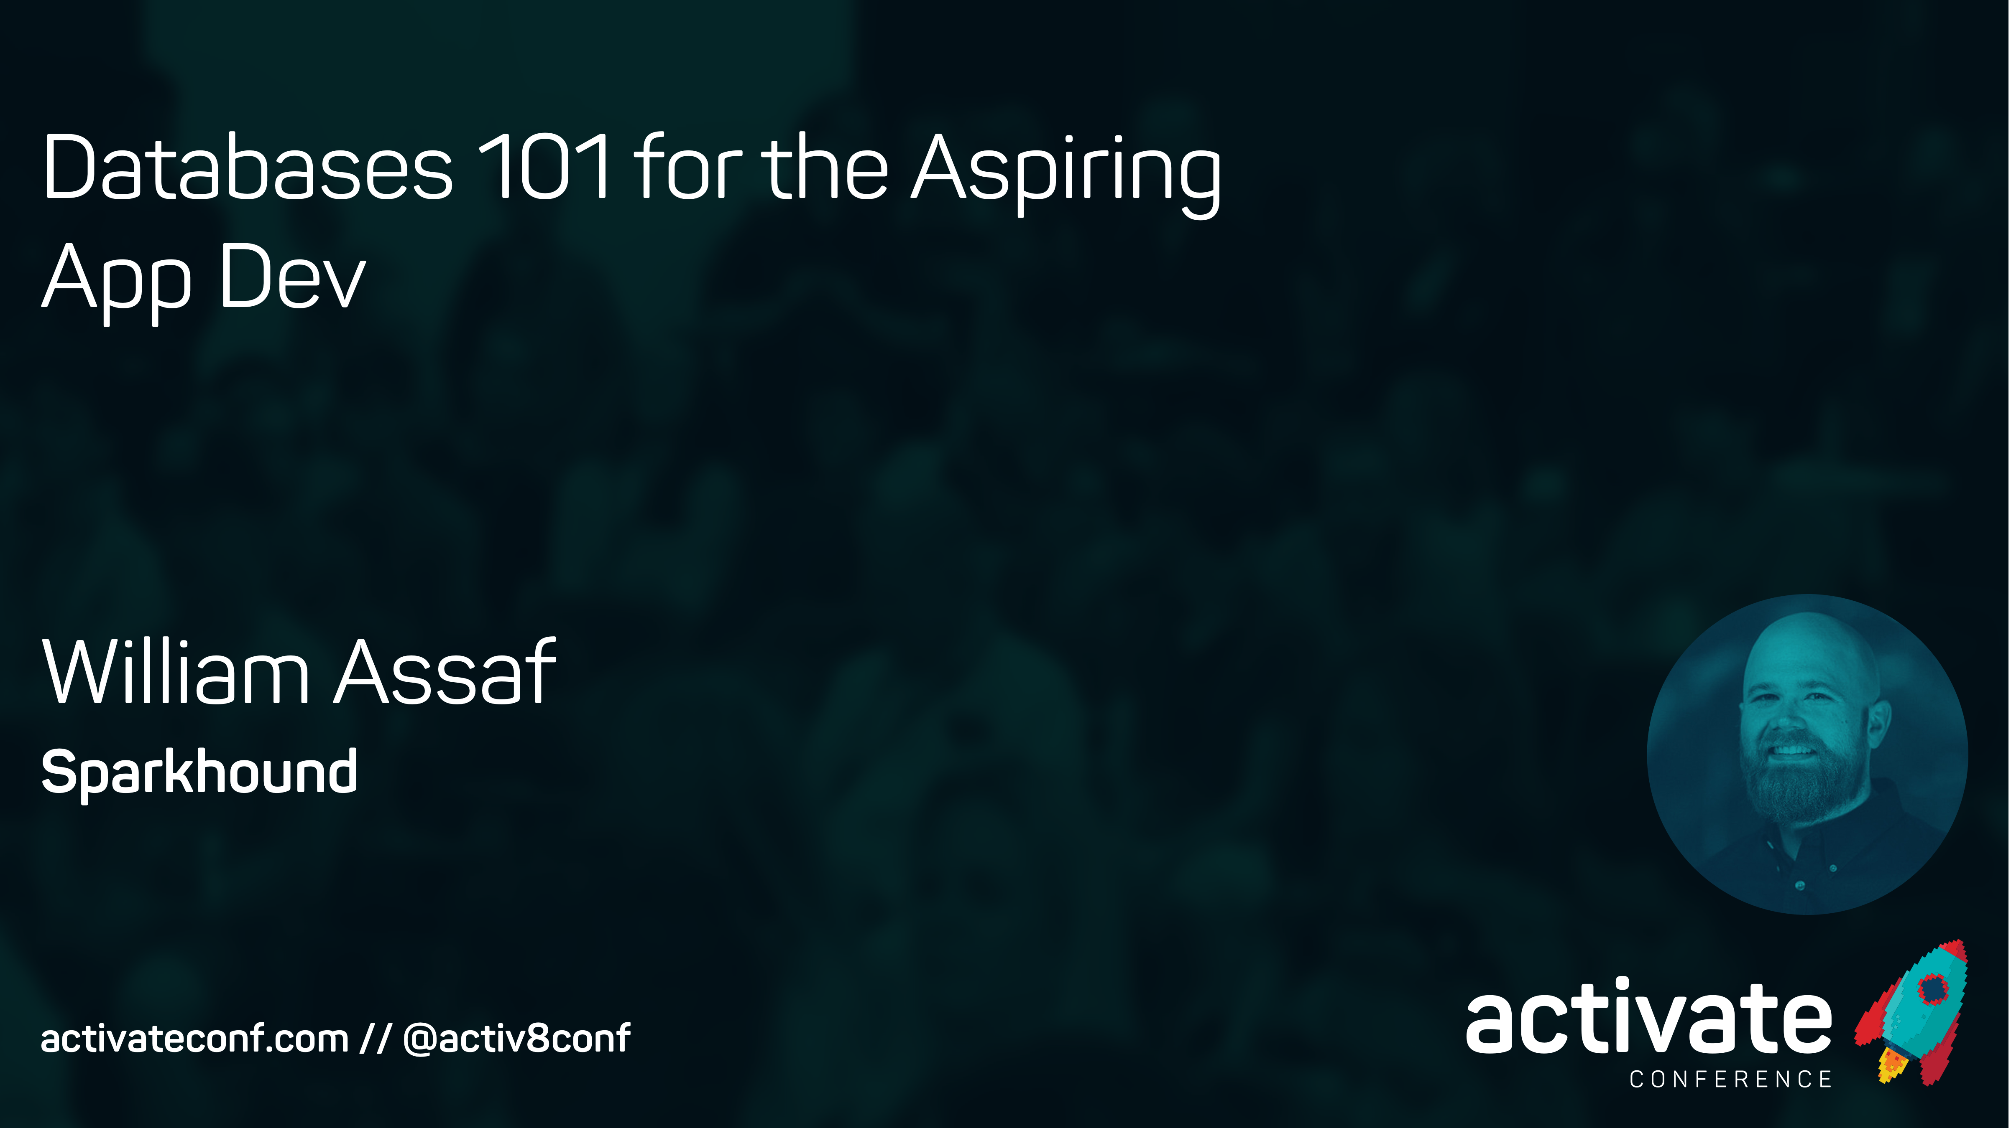
Databases 101 for the Aspiring App Dev
William Assaf

Slide 2
Databases 101 for the Aspiring App Dev
Differences between a database and other storage options
What’s NOT a database
What is a database
ACID compliant
SQL Server Tooling
How to Get SQL Server
DR basics
Security Basics
Normalization
Live demo

Slide 3
Workshop Logistics
Ask questions! I’ll try to answer to everyone.
Scripts and slides (for both Activate presentations) are already posted on my blog at sqltact.com so that you can follow along, click these links!
On Twitter?
#activ8conf
@activ8conf and @william_a_dba

Slide 4
PREPARE FOR A VOCABULARY DUMP
Throw a lot at you, so you’re over that initial barrier
This presentation will focus on MS SQL Server, but what should you know about database platforms in general?
What’s happening the in the data industry today?
Buckle up!
Why is this important?

Slide 5

I Was Once
A Very
Crappy
Carpenter
Notes:
SLIDE PURPOSE: This is where everything starts – us defining with our customers how we can make an impact in their business regardless of the technology!
SPIEL: Technology should be transformative, not a to-do list. Because, really, just about any firm can change the way your IT works. Our mission is for IT to change the way your business works. The difference is a game-changer.

Slide 6
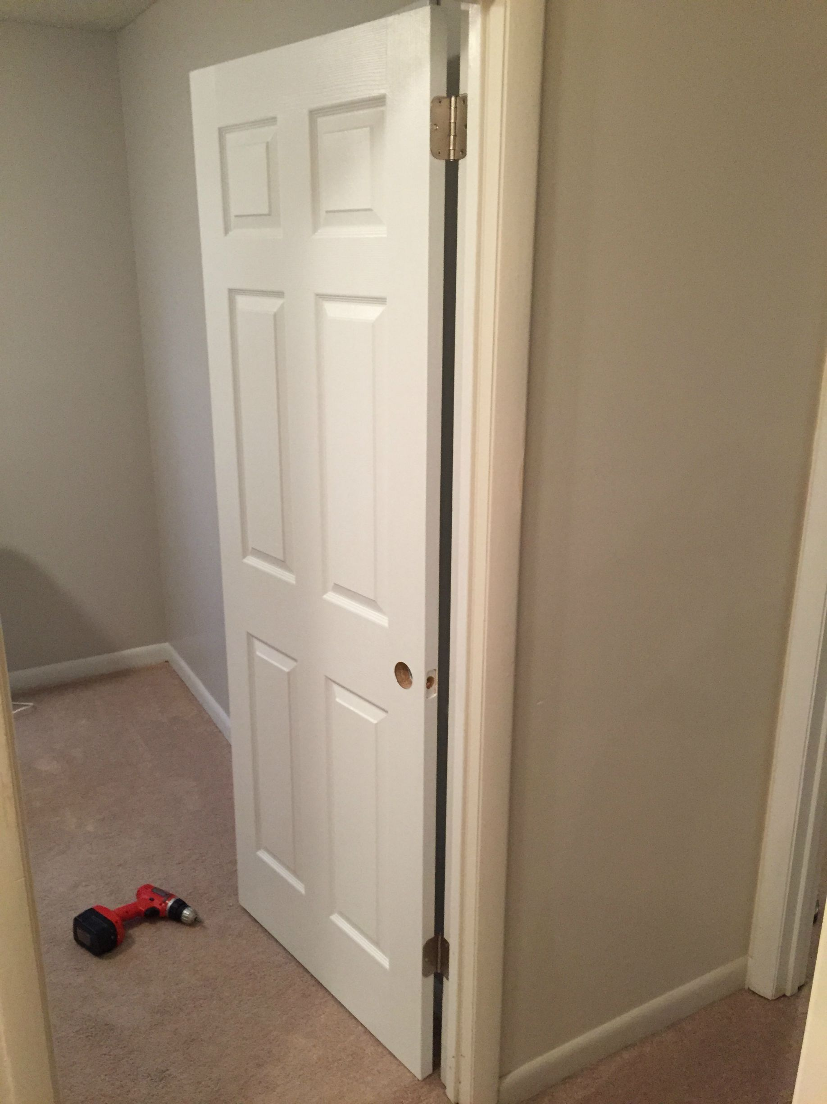
Notes:
SLIDE PURPOSE: This is where everything starts – us defining with our customers how we can make an impact in their business regardless of the technology!
SPIEL: Technology should be transformative, not a to-do list. Because, really, just about any firm can change the way your IT works. Our mission is for IT to change the way your business works. The difference is a game-changer.

Slide 7
Side projects?
Interest in my work outside?
Certification exams?
User Groups and Conferences (like this)?
Nope.
Minimum effort? Yep.
Notes:
SLIDE PURPOSE: This is where everything starts – us defining with our customers how we can make an impact in their business regardless of the technology!
SPIEL: Technology should be transformative, not a to-do list. Because, really, just about any firm can change the way your IT works. Our mission is for IT to change the way your business works. The difference is a game-changer.

Slide 8
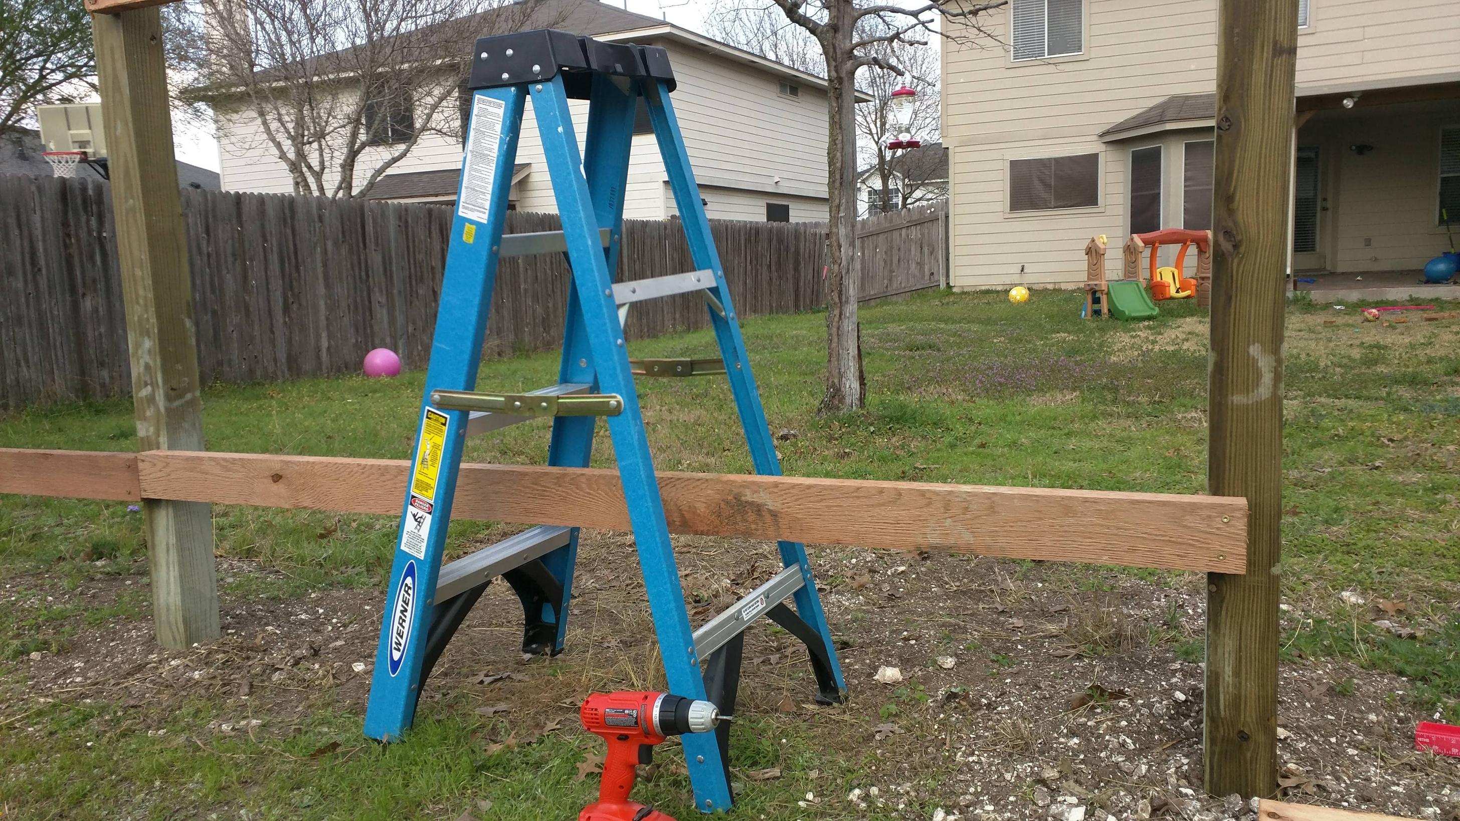
Notes:
SLIDE PURPOSE: This is where everything starts – us defining with our customers how we can make an impact in their business regardless of the technology!
SPIEL: Technology should be transformative, not a to-do list. Because, really, just about any firm can change the way your IT works. Our mission is for IT to change the way your business works. The difference is a game-changer.

Slide 9
I just did what I was told. I didn’t really try to expand or fine tune my skillset.
Those video games weren’t going to play themselves, amiright?
I was just doing the job.
And I made goofs all the time
because it was just a job.
Notes:
SLIDE PURPOSE: This is where everything starts – us defining with our customers how we can make an impact in their business regardless of the technology!
SPIEL: Technology should be transformative, not a to-do list. Because, really, just about any firm can change the way your IT works. Our mission is for IT to change the way your business works. The difference is a game-changer.

Slide 10

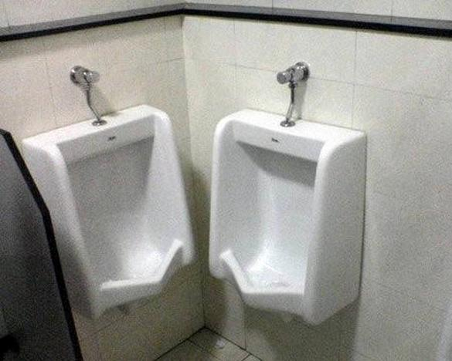
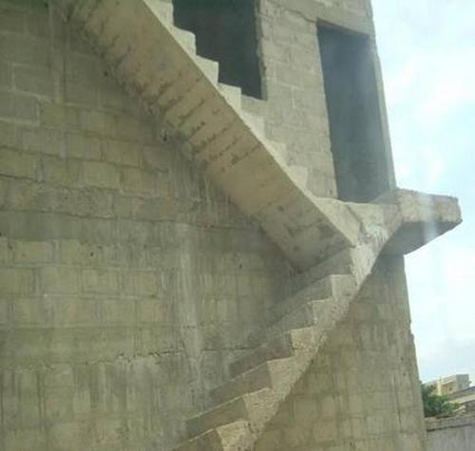
Notes:
SLIDE PURPOSE: This is where everything starts – us defining with our customers how we can make an impact in their business regardless of the technology!
SPIEL: Technology should be transformative, not a to-do list. Because, really, just about any firm can change the way your IT works. Our mission is for IT to change the way your business works. The difference is a game-changer.

Slide 11
I just wasn’t very good.
I wanted be a better carpenter, I really did…
but couldn’t find time to make myself into one.
That was my employer’s responsibility...
…right?
Notes:
SLIDE PURPOSE: This is where everything starts – us defining with our customers how we can make an impact in their business regardless of the technology!
SPIEL: Technology should be transformative, not a to-do list. Because, really, just about any firm can change the way your IT works. Our mission is for IT to change the way your business works. The difference is a game-changer.

Slide 12
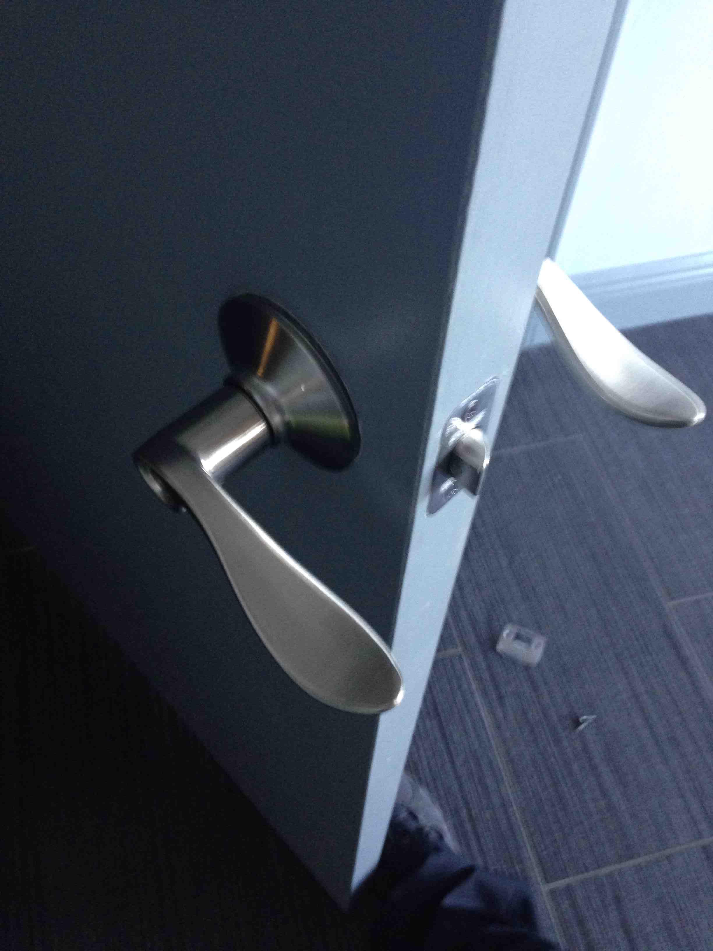
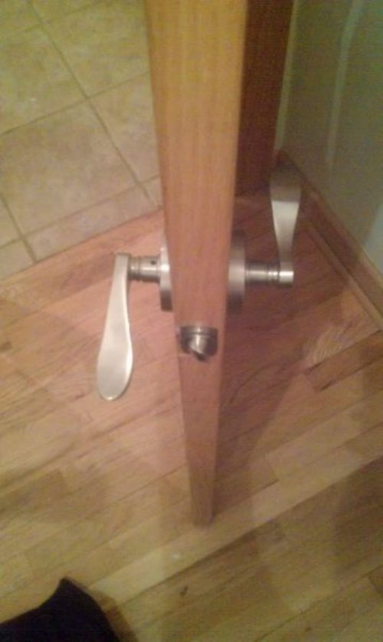
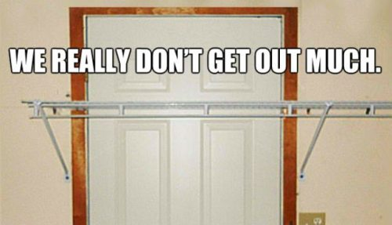
Notes:
SLIDE PURPOSE: This is where everything starts – us defining with our customers how we can make an impact in their business regardless of the technology!
SPIEL: Technology should be transformative, not a to-do list. Because, really, just about any firm can change the way your IT works. Our mission is for IT to change the way your business works. The difference is a game-changer.

Slide 13
Sometimes what we want to be
and what we do at work every day
aren’t the same thing.
Who’s problem is that?
Notes:
SLIDE PURPOSE: This is where everything starts – us defining with our customers how we can make an impact in their business regardless of the technology!
SPIEL: Technology should be transformative, not a to-do list. Because, really, just about any firm can change the way your IT works. Our mission is for IT to change the way your business works. The difference is a game-changer.

Slide 14
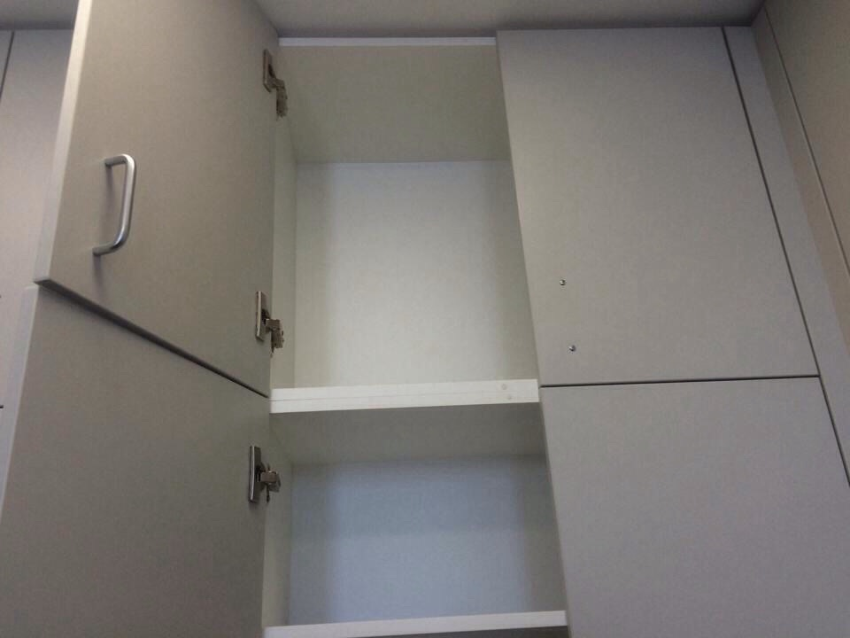
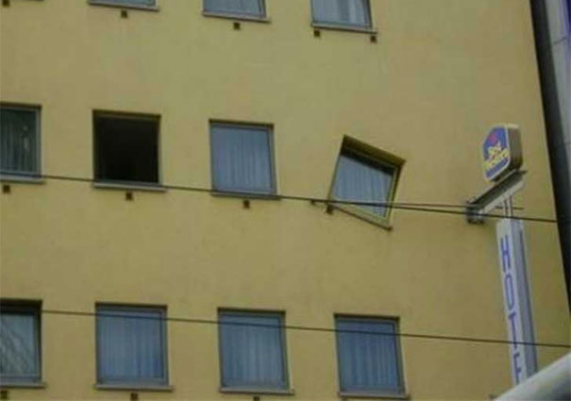
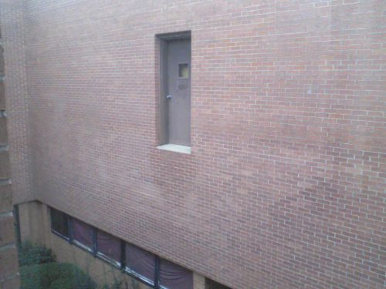
Notes:
SLIDE PURPOSE: This is where everything starts – us defining with our customers how we can make an impact in their business regardless of the technology!
SPIEL: Technology should be transformative, not a to-do list. Because, really, just about any firm can change the way your IT works. Our mission is for IT to change the way your business works. The difference is a game-changer.

Slide 15
So I started studying on my own time.
I showed interest, paid more attention.
I stopped pointing out roadblocks, and started developing solutions.
I started attending local User Groups and events
I created my own related side projects, even if no one ever knew about them.
I passed an cert exam. It was tough!
And THEN I got into a good work situation with experience around me.
Notes:
SLIDE PURPOSE: This is where everything starts – us defining with our customers how we can make an impact in their business regardless of the technology!
SPIEL: Technology should be transformative, not a to-do list. Because, really, just about any firm can change the way your IT works. Our mission is for IT to change the way your business works. The difference is a game-changer.

Slide 16
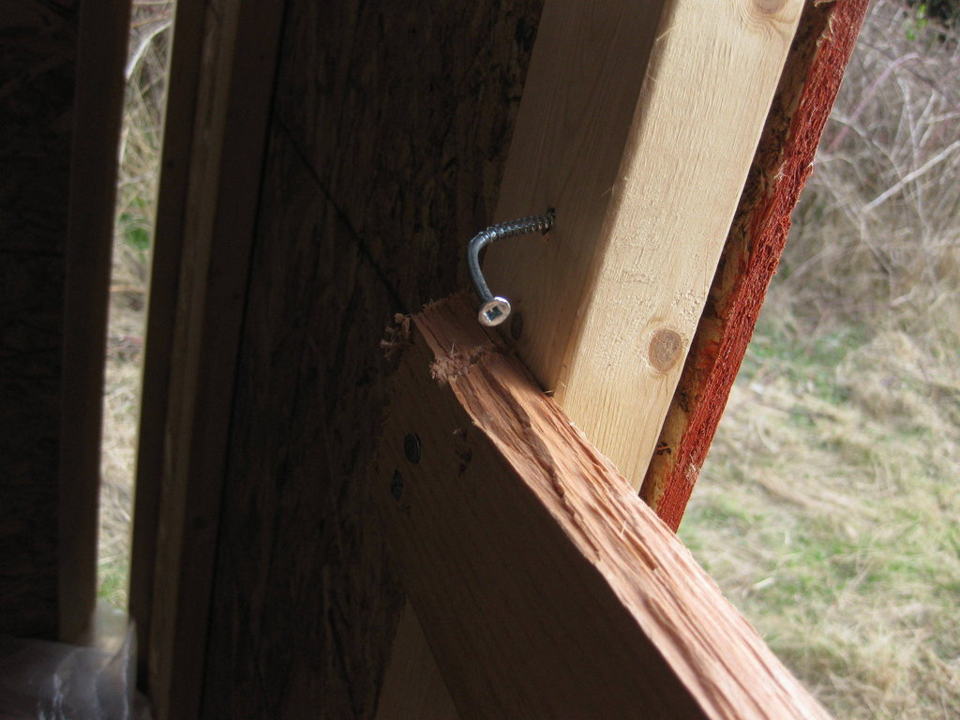
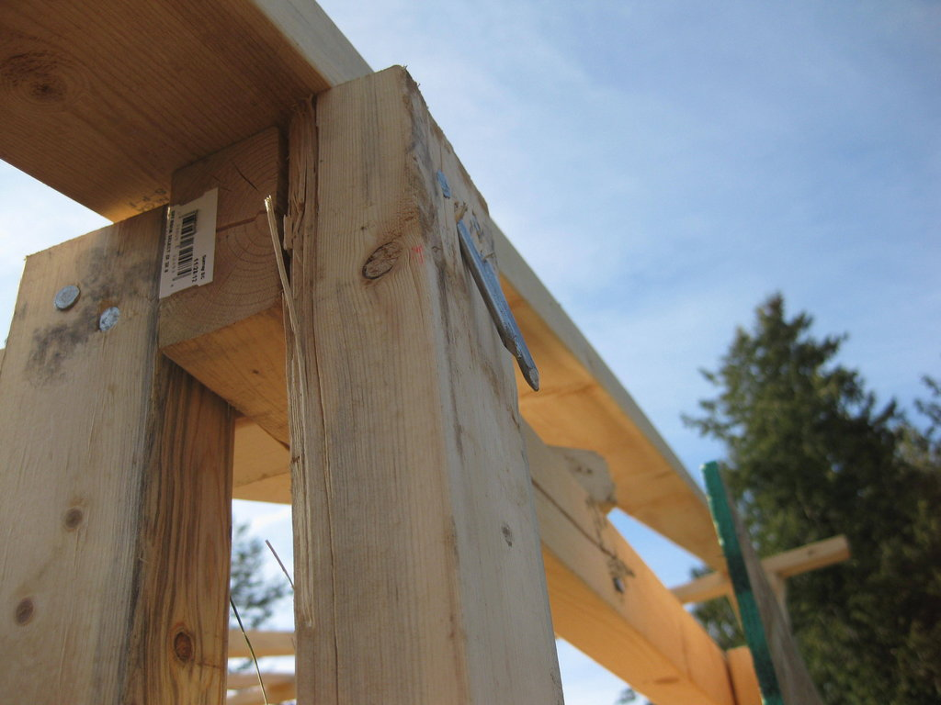
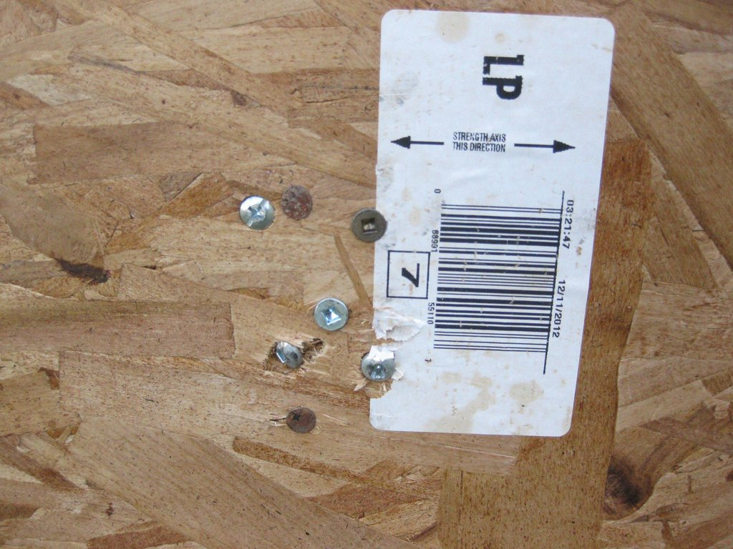

Notes:
SLIDE PURPOSE: This is where everything starts – us defining with our customers how we can make an impact in their business regardless of the technology!
SPIEL: Technology should be transformative, not a to-do list. Because, really, just about any firm can change the way your IT works. Our mission is for IT to change the way your business works. The difference is a game-changer.

Slide 17
I started learning again.
Did I make mistakes? Sure.
But I was on the path.
Notes:
SLIDE PURPOSE: This is where everything starts – us defining with our customers how we can make an impact in their business regardless of the technology!
SPIEL: Technology should be transformative, not a to-do list. Because, really, just about any firm can change the way your IT works. Our mission is for IT to change the way your business works. The difference is a game-changer.

Slide 18

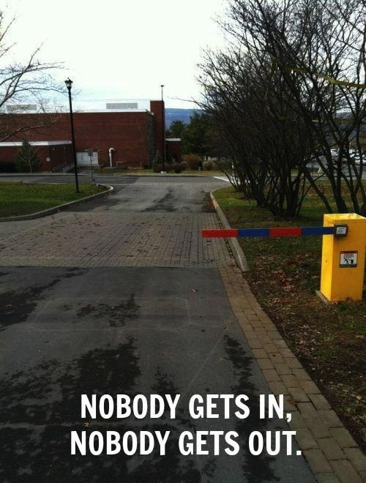
Notes:
SLIDE PURPOSE: This is where everything starts – us defining with our customers how we can make an impact in their business regardless of the technology!
SPIEL: Technology should be transformative, not a to-do list. Because, really, just about any firm can change the way your IT works. Our mission is for IT to change the way your business works. The difference is a game-changer.

Slide 19
You are not [going to be] a good carpenter
if your own house isn’t full of the tools of your trade and your own projects.
The only way to learn is to do.
Don’t expect to learn everything from your school or employer.
Notes:
SLIDE PURPOSE: This is where everything starts – us defining with our customers how we can make an impact in their business regardless of the technology!
SPIEL: Technology should be transformative, not a to-do list. Because, really, just about any firm can change the way your IT works. Our mission is for IT to change the way your business works. The difference is a game-changer.

Slide 20
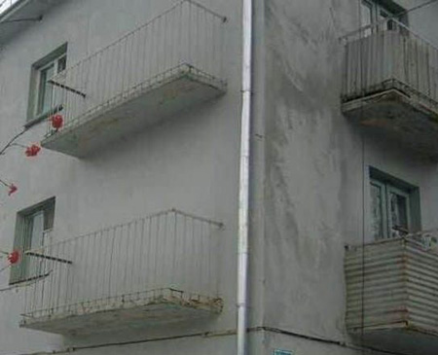
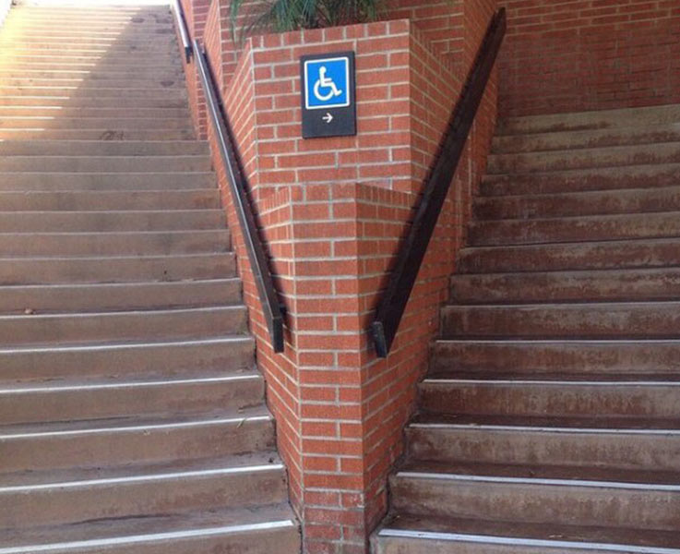
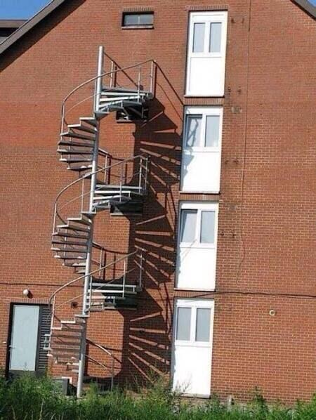
Notes:
SLIDE PURPOSE: This is where everything starts – us defining with our customers how we can make an impact in their business regardless of the technology!
SPIEL: Technology should be transformative, not a to-do list. Because, really, just about any firm can change the way your IT works. Our mission is for IT to change the way your business works. The difference is a game-changer.

Slide 21

Join SQL PASS (sqlpass.org) and/or other tech organizations for your field
Join your local User Group (BRSSUG.org has links to many)
Go to stuff like this: congrats, you’re already here!
All this stuff is really good for your professional networking!

Slide 22
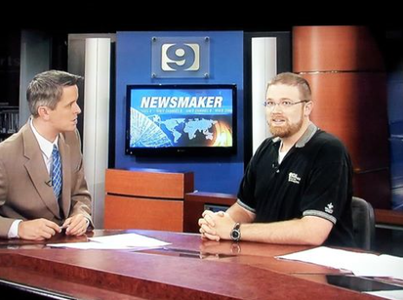
Share your experience and knowledge with this community because:
The more skilled professionals
there are in your region,
the more good IT work
there will be to do

Slide 23
Write a blog post explaining a topic in your field, even if it beginner-level
Give a 10-15 min Lightning Round talk to your local user group
Give a lunch and learn at your office
Give a 60 presentation to your local user group
Give a presentation at SQLSaturday or Tech Fest or Activate Conference

Slide 24
Also:
Get organized. Keeping getting more organized than you were before. Take notes in OneNote or Keep or something, not on paper.
Get a task list, calendar, etc.
The method and idea needs to be YOURS.
Stop fearing being wrong, start fearing becoming obsolete. Stay technical!
Learn to admit when you’re wrong, and stop wasting time covering it up.

Slide 25
Also:
3. Think you understand something? Find out.
Try blogging about it, or speaking about it.
4. Have a can-do attitude.
Don’t be a fault-finder.
Don’t think of roadblocks as a default method of contributing to discussion.
Start treating your fellow students, coworkers, and colleagues in the community like friends, not like assets or competition or frenemies.

Slide 26
Also:
Never pass up an opportunity to give a sincere "Great job!"
Never ask a woman if she is pregnant.
Never ask a woman if she is a “booth babe”.
Don’t hate.
Caffeinate.

Slide 27
Ready?

Slide 28

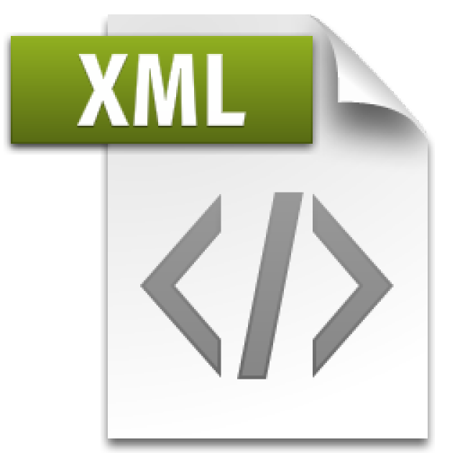

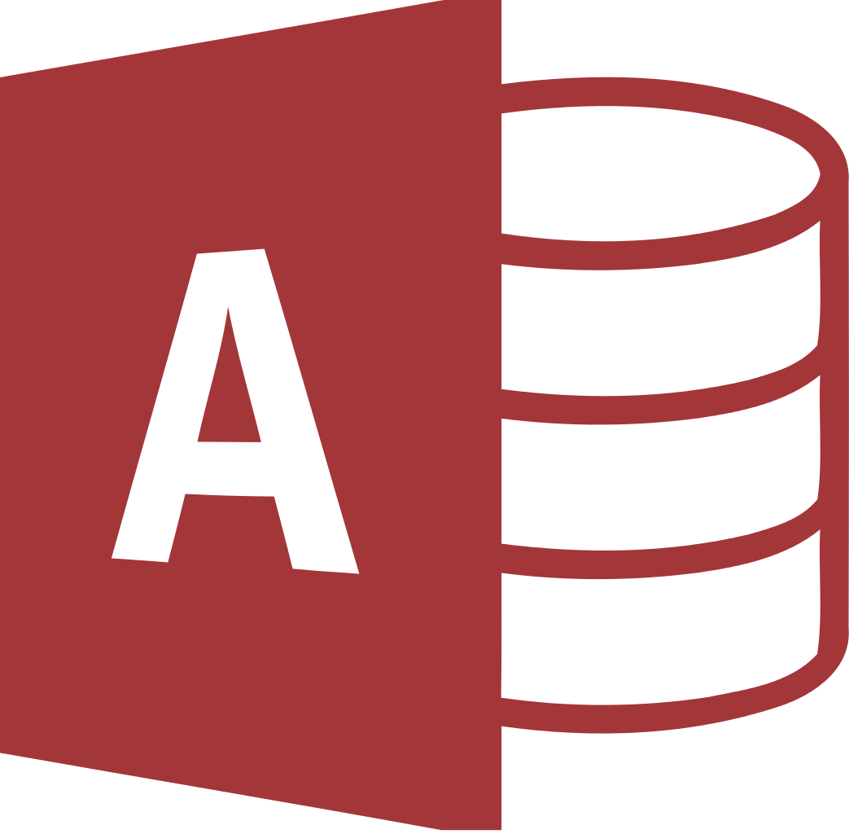
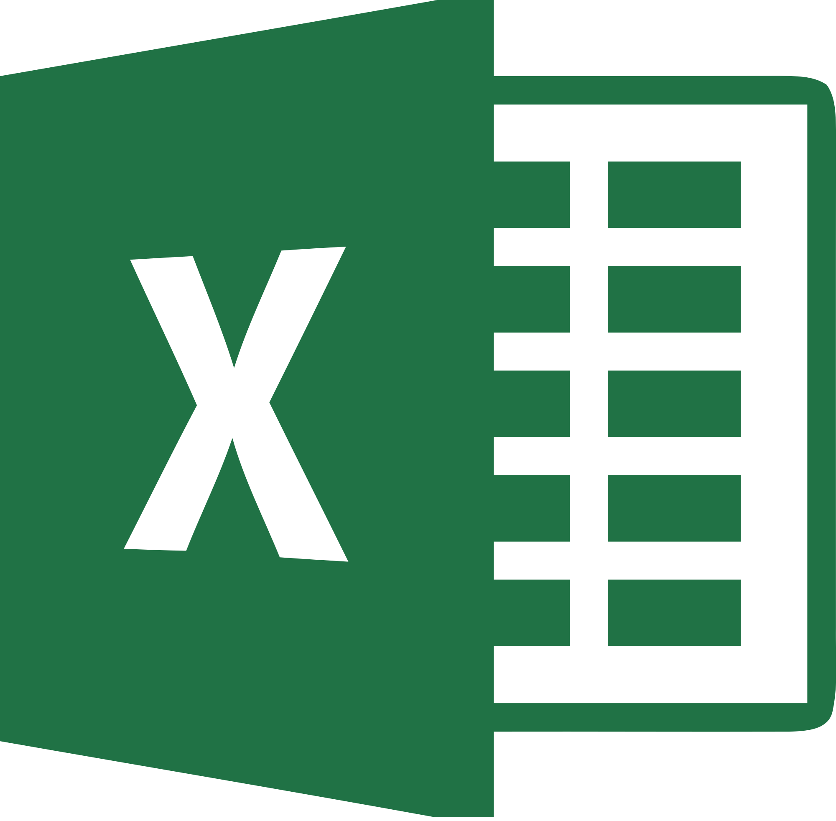
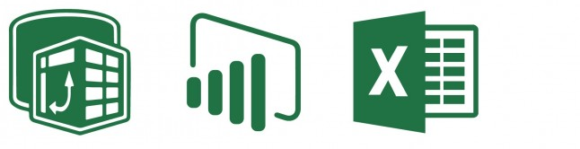
What’s Not a Database
Flat files
Including json and xml
Azure Table storage
Microsoft Access databases
Not designed for Concurrency
Excel - most popular BI tool in the world
There are dangers of "silo'ing" data
The Excel, PowerPivot, PowerBI stack
Though, valuable tools for self-service business intelligence
But not a database!

Slide 29
What’s Not a Database
Things that are NOT databases may do just fine:
Store data for retrieval, even querying, by a user
Have data appended
Maybe even have some optional structure around data types
Things that are NOT databases are not designed for:
Strongly-typed data validation
Transactional processing, isolated updates
Disaster Recovery / High Availability
Concurrency (multiple users)
Corruption Detection
Much more…

Slide 30
MS Access is a “Database Simulator”
Microsoft Access documentation is full of caveats about the lack of concurrency and scalability for Access.
The 32-bit "Microsoft Jet [the database engine inside Access] can only handle a limited number of sessions."
"...when multiple concurrent users make requests of a Microsoft Access database, unpredictable results may occur."
"...it was not intended (or architected) for high-stress performance..."

Slide 31
What is a Database
Products like Microsoft SQL Server (and Azure SQL DB)
Competitors: Oracle, MySQL, PostgreSQL, IBM DB2, SQLite
All follow some implementation of a universally accepted standard language for data platforms:
SQL – “Structured Query Language”
SELECT … FROM … WHERE …
Microsoft’s implementation = TSQL
Oracles implementation = PLSQL
Basics are same, but many important vendor-specific features are nonstandard, not interchangeable, require cross-training

Slide 32
SQL
“Structured Query Language”
“Sequel” not “Ess Que Ell”
“SQL Server” is the name specifically for the Microsoft database platform

Slide 33
ACID Compliant Databases
Atomic
A transaction is all or nothing
Consistent
Transaction brings the entire database from one state to another - not just a single part of the database
Eventual consistency can be useful - Cassandra, MongoDB, Redis
Isolated
Transactions, though handled concurrently, are still processed sequentially and independently
Incomplete transactions should not be visible to other transactions
Durable
If the power goes off, the data is still there. It's not stored in volatile memory.

Slide 34
NoSQL
NoSQL isn’t a product, it’s a category, similar to “Big data”
Big data storage: Apache Hadoop, Azure Blob Storage, Spark
NoSQL platform examples: RavenDB, MongoDB, Amazon DynamoDB.
Amazon, Facebook, Google have their own platforms
There are vendors who have specialized in it all along
Twitter originally used Cassandra, now they use their own “Twitter-scale” distributed database platform, Manhattan

Slide 35
NoSQL
One of the charecteristics (and common use cases) of a NoSQL database is eventual consistency.
Twitter cannot commit a transaction globally, synchronously
Your hot taek tweet takes some time to propagate globally through the distributed database system
Other aspects of ACID may be violated in name of performance, and as long as the devs are aware, it’s OK.
This would be completely unacceptable for:
A stock exchange (NASDAQ – runs on MS SQL Server)
A sportsbook (Bwin – runs on MS SQL Server)

Slide 36
NoSQL
Microsoft isn’t without NoSQL offerings:
PolyBase is a feature inside MS SQL to query big data in Hadoop or Azure Blob storage with TSQL
Many different MS SQL features that break ACID
CosmosDB –new planet-scale database platform
This presentation focuses on MS SQL Server

Slide 37
PaaS Revolution
MS SQL Server is installed, configured, maintained
What if there was an offering that provided everything for you, automated, without maint?
Platform-as-a-Service
An instance of a database is created for you, with easy UI to interact, no maintenance, backups, storage config needed
Scalable – change CPU/memory/storage capacity on the fly
Examples: Azure SQL DB, Amazon RDS
Infrastructure-as-a-Service
Here’s a VM. Have fun. But you don’t have to worry about the network layer, redundant power, physical disks. Also scalable.

Slide 38
How to get SQL Server - Editions
This is the link to download SQL for FREE:
Do a web search: SQL Server 2017 Downloads, click Developer
Free editions of SQL: Developer (good), Express (bad!)
Developer is same as Enterprise, but cannot be used in production
Standard edition is not free, but is roughly 20% the $ of Enterprise

Slide 39
How to get SQL Server - Tools
The tools to dev in the Microsoft ecosystem are all free, just do a web search:
SSMS (for the SQL Server)
SSDT (for SSRS, SSIS, SSAS, also for Database Projects) (installs a shell of Visual Studio)
Visual Studio Community Edition or Visual Studio Code

Slide 40
What you need
Toolbox link: in Github, or link at the top of sqltact.com
Look for toolbox.zip for an easy download, or
Click on each file then download, or
Click on each file, click “raw” on each file to copy/paste
WideWorldImporters sample database:
WideWorldImporters-Full.bak (restore to any SQL Server Edition aside from LocalDB)

Slide 41
Accessing your SQL Server
Now that it is installed, how do you log in to it?
During install, you’re given a chance to:
Add initial administrators. Use your domain account (if applicable) or local windows user, or a Windows/AD security group that you are in.
If you activate SQL Authentication, provide a password for the ‘sa’ login.
Heads up – avoid using ‘sa’ whenever possible, especially not in your apps!!
Use Windows Auth whenever possible.

Slide 42
Logins vs Users
Database User
Set a database context
Linked to a Server Login
Does not have a password
Assigned to Database Roles
Stored in the User Database
Brought along with a User DB Restore
Given access to SELECT, ALTER, EXECUTE, CREATE TABLE
Server Login
Connect to a SQL Server
Can be linked to AD (Windows)
Can have a password (SQL)
Assigned to Server Roles
Stored in the Master database
Not affected by User DB Restore
Given access to BACKUP, RESTORE, CONNECT, CREATE DATABASE

Slide 43
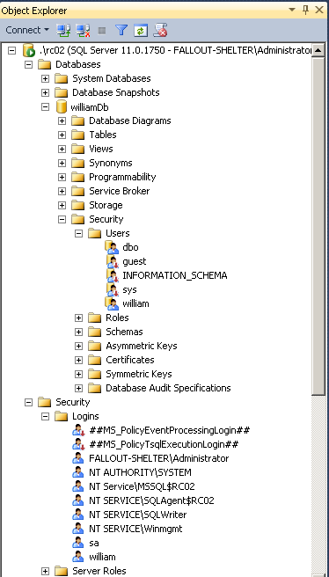
Database User
Set a database context
Linked to a Server Login
Does not have a password
Assigned to Database Roles
Stored in the User Database
Brought along with a User DB Restore
Server Login
Connect to a SQL Server
Can be linked to AD (Windows Login)
Can have a password (SQL Login)
Assigned to Server Roles
Stored in the Master database
Not affected by User DB Restore

Slide 44
Server Logins
A Server Login is a server-level security principal.
Logins are given a default database. CONNECT will fail if the Default Database is no longer present or accessible.
Just use tempdb as the default database for admins.
In order to access data in a database, must be linked to a Database User.

Slide 45
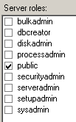
Server Login Roles
Server Logins are most commonly added to Server Roles, which are self-explanatory and well documented.

Slide 46
Windows Auth vs SQL Auth
In a domain environment,
AD authentication means that
account creation/termination,
security group membership,
password policy,
are handled by an existing corporate security administration infrastructure.

Slide 47
Windows Auth vs SQL Auth
Windows Authentication is the default security model for SQL Server and cannot be disabled.
Enable “Mixed Mode” to allow for SQL Logins
Choosing Mixed Mode as a server option enables SQL Logins and allows the “sa” account to be enabled.

Slide 48
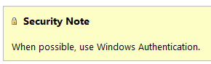
SQL Auth
SQL Logins are authenticated by SQL Server.
Strongly encouraged to Enforce password policy, which can include password expiration.
Multiple failed SQL auth login attempts will Lock Out.

Slide 49
Database Users
A Database User is a database level security principal.
A Database User can be linked to any Login (Windows or SQL Auth) – and the names don’t actually have to match.
Database Users have a sid, such as 0xE5EFF2DB1688C246855B013148882E75
which is shared by the linked Server Login.

Slide 50
SQL Auth Logins
SQL Auth Logins can become disconnected from their Database Users when a database is restored from another server.
This isn’t a problem with Windows Authenticated logins.
To re-associate a database user to a server login:
ALTER USER username WITH LOGIN = loginname;

Slide 51
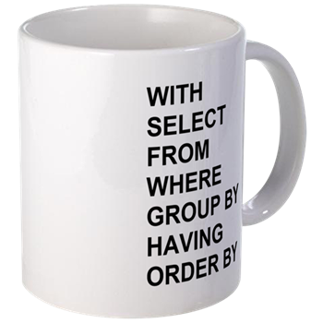
Basics of TSQL
WITH
SELECT
FROM
WHERE
GROUP BY
HAVING
ORDER BY;

Slide 52
Basics of SQL
WITH
SELECT – what column(s)
FROM – from what table(s)
WHERE – with what filter(s)
GROUP BY
HAVING
ORDER BY – in what order;

Slide 53
Basics of SQL
WITH – use a CTE
SELECT – what column(s)
FROM – from what table(s)
WHERE – with what filter(s)
GROUP BY – aggregate by these
HAVING – filter the aggregates
ORDER BY – in what order;

Slide 54
SQL Examples
Toolbox: lab - TSQL 101.sql
This syntax in these samples is simple enough that it should work with minimal alteration in any ANSI SQL-compliant database platform.

Slide 55
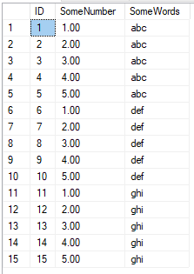
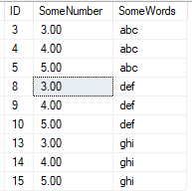
Basics of SQL
--Not best practice
--Use Schema.objectname
--Semicolon please!
Better:
SELECT ID, SomeNumber, SomeWords
FROM dbo.SomeTable
WHERE SomeNumber > 2;
Let’s say I only want all columns from this table, but only the rows where
SomeNumber > 2
Works:
SELECT *
FROM SomeTable
WHERE SomeNumber > 2

Slide 56
Comments
Yes, you should comment your TSQL.
--comment the rest of this line
/*
Comment a whole block of text
*/

Slide 57
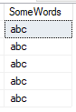
Basics of SQL
I only want SomeWords that begin with ‘a’
Works:
SELECT SomeWords
FROM dbo.SomeTable
WHERE SomeWords like 'a%'
Also works:
SELECT SomeWords
FROM dbo.SomeTable
WHERE LEFT(SomeWords, 1) = 'a'
Lots of different string manipulation functions:
https://docs.microsoft.com/en-us/sql/t-sql/functions/string-functions-transact-sql

Slide 58
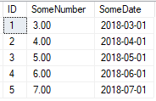
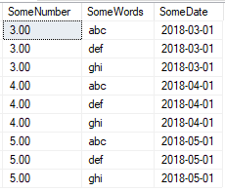
Basics of SQL
I have another table with SomeNumber.
But second table has important dates. I need to join the two tables on SomeNumber, and display data only where I find a match.
Works:
SELECT SomeTable.SomeNumber, SomeWords, SomeDate
FROM dbo.SomeTable --No table aliases
INNER JOIN dbo.SomeTable2
ON SomeTable.SomeNumber = SomeTable2.SomeNumber
ORDER BY SomeTable.SomeNumber;
Better:
SELECT t1.SomeNumber, t1.SomeWords, t2.SomeDate
FROM dbo.SomeTable AS t1
INNER JOIN dbo.SomeTable2 AS t2
ON t1.SomeNumber = t2.SomeNumber
ORDER BY t1.SomeNumber, t1.SomeWords, t2.SomeDate;
Better:
SELECT t1.SomeNumber, t1.SomeWords, t2.SomeDate
FROM dbo.SomeTable AS t1
INNER JOIN dbo.SomeTable2 AS t2
ON t1.SomeNumber = t2.SomeNumber
ORDER BY t1.SomeNumber, t1.SomeWords, t2.SomeDate;

Slide 59

Joins
Source: https://www.codeproject.com/Articles/33052/Visual-Representation-of-SQL-Joins

Slide 60
MS SQL File Basics
Even for the databases you have locally on your development machine, DR things you need to know:
Each SQL Server database has at least
one data file (.mdf)
one transaction log file (.ldf)
The transaction log file contains any write or alteration
The data file will grow as you add data
The log file will grow as you add or modify data

Slide 61
MS SQL Backup Basics
Three types of backups for a SQL Server
Full
Start of any recovery chain
Differential
Based on a full
Transaction Log (behaves like an incremental)
Log backups are the most critical for you to understand.
They form a chain, starting with a Full or Differential
Taking a log backup empties the transaction log file (the .ldf)
This is extremely important to understand!

Slide 62

The Microsoft SQL Server Transaction Log
Windows sees
1GB file
SQL sees
1GB reservation
with ~1GB free
Windows sees
1GB file
SQL has used up the space, the file must grow
Transactions
+10%
Transactions
+10%
Transactions
Windows sees
1.1GB file
SQL sees
1GB reservation
with ~.1GB free
Windows sees
1.21GB file
SQL sees
1.1GB reservation
with ~.11GB free
Transactions
Transactions
Transactions
Transactions
.LDF file

Slide 63
Database Recovery Model and the Transaction Log
Simple
Transactions are quickly, automatically cleared from Log
No Log backups
No Point in Time Recovery (Full/Diff backups only)
Appropriate for DEV/TEST
Full
Transactions stay in Log until truncated
Log backups taken regularly –or– Log will grow unchecked!
Point in Time recovery is possible and desirable
Appropriate for PROD, or read-only/nighty reporting systems

Slide 64
Database Recovery Model
So what recovery model is appropriate for your local development databases or pre-production databases?
SIMPLE
What recovery model is appropriate for your Production databases?
FULL
And then you scheduled Transaction Log backups every hour
Guidance: No less frequently than every hour.
Any less frequent and you’re missing the point

Slide 65
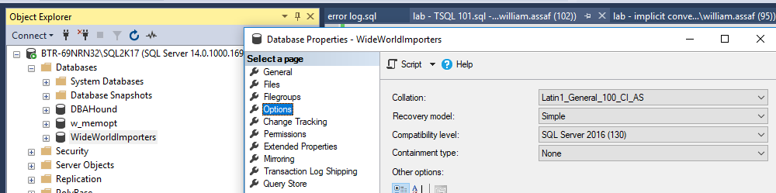
Database Recovery Model
In SQL Server Management Studio:

Slide 66
Flatten Tables vs Normalized Tables
Flattened
To express 1-to-Many relationships, must grow horizontally by adding columns
(example: Phone1, Phone2…)
No good for transactions, can be useful for reporting
Difficult to add type attributes (will demonstrate)
Normalized
Reduces duplicate data
Helps identify relationships between data
Allows for 1-to-Many relationships by adding rows

Slide 67
Normalized Table Design
Normal Forms
Academic study of Normal Forms
3NF (Third Normal Form) is most common
Important to identify in almost every table:
Primary Key
Unique Key
Foreign Key
Natural Key
Surrogate Key

Slide 68
Keys
Primary Key
Identify parent relationships to other tables
Unique Key
Identify uniqueness(es), can have more than one
Foreign Key
Identify this column as a child to another table
Natural Key
Business-generated key
Surrogate Key
System-generated key

Slide 69
Keys
Primary Key
Identify parent relationships to other tables
Unique Key
Identify uniqueness(es), can have more than one
Foreign Key
Identify this column as a child to another table
Natural Key
Business-generated key
Surrogate Key
System-generated key
Often these keys are on the same column, when we create an IDENTITY column.
Also commonly serves as the Key to clustered index.

Slide 70
Keys
Primary Key
Identify parent relationships to other tables
Unique Key
Identify uniqueness(es), can have more than one
Foreign Key
Identify this column as a child to another table
Natural Key
Business-generated key
Surrogate Key
System-generated key
These two MUST NOT be the same!
Users should never see Surrogate Keys, and Surrogate Keys should never change.
Users should only see Natural keys, and can therefore change these values.

Slide 71
Keys
Primary Key
Identify parent relationships to other tables
Unique Key
Identify uniqueness(es), can have more than one
Foreign Key
Identify this column as a child to another table
Natural Key
Business-generated key
Surrogate Key
System-generated key
Primary Keys are always unique, but you can have more than one Unique Key. You can have a Primary Key on an IDENTITY field, and also enforce uniqueness on one or more other columns.

Slide 72
Keys
Primary Key
Identify parent relationships to other tables
Unique Key
Identify uniqueness(es), can have more than one
Foreign Key
Identify this column as a child to another table
Natural Key
Business-generated key
Surrogate Key
System-generated key
Foreign Keys reference the Primary Key of another table.
Surrogate Keys are the best choice for PK and FK’s, because they can never change.

Slide 73
Normalization Antipatterns
Bad (one table)
Student
NAME(key)_PHONE1_PHONE2_PHONE3_PHONE4…
Good (three tables):
Student
ID(key)_NAME
StudentPhone
ID(key)_StudentID_PhoneNum_PhoneTypeID
PhoneType
ID(key)_TYPE

Slide 74
Normalization Antipatterns
Bad (one table)
Student
NAME(key)_PHONE1_PHONE2_PHONE3_PHONE4…
B Smith 2255555555 2254444444 2253333333 NULL
J Smith 2255555555 2254444444 NULL NULL
K Smith 2255555555 2254444444 2251111111 2259999999
Good (three tables): Student
ID(key)_Name
StudentPhone 1 B Smith
ID(key)_StudentID_PhoneNum_PhoneTypeID 2 J Smith
1 1 2255555555 1 3 K Smith
2 1 2254444444 1
3 1 2253333333 2 PhoneType
4 2 2255555555 1 ID(key)_Type
5 2 2254444444 2 1 Mobile
6 3 2255555555 1 2 Home
7 ….

Slide 75
Normalization Exercise
We’ll use a whiteboard or SSMS’s built-in database diagram designer to design a normalized table structure.
What hobbies do we have?
What do we know the business logic well?

Slide 76
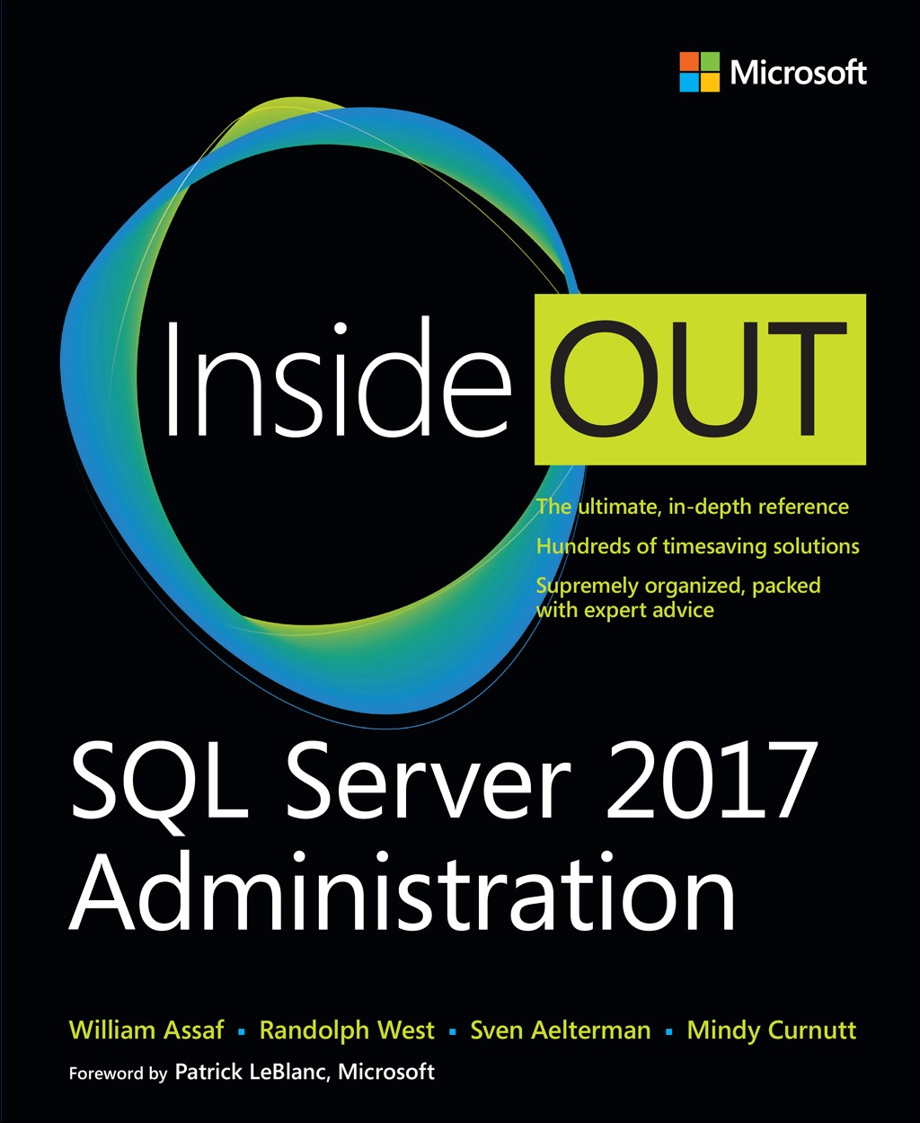
Save 40% on book or eBook
with discount code SQL
www.microsoftpressstore.com
Free U.S. shipping
eBooks include EPUB, PDF, & MOBI
Offer expires May 31, 2018

Slide 77

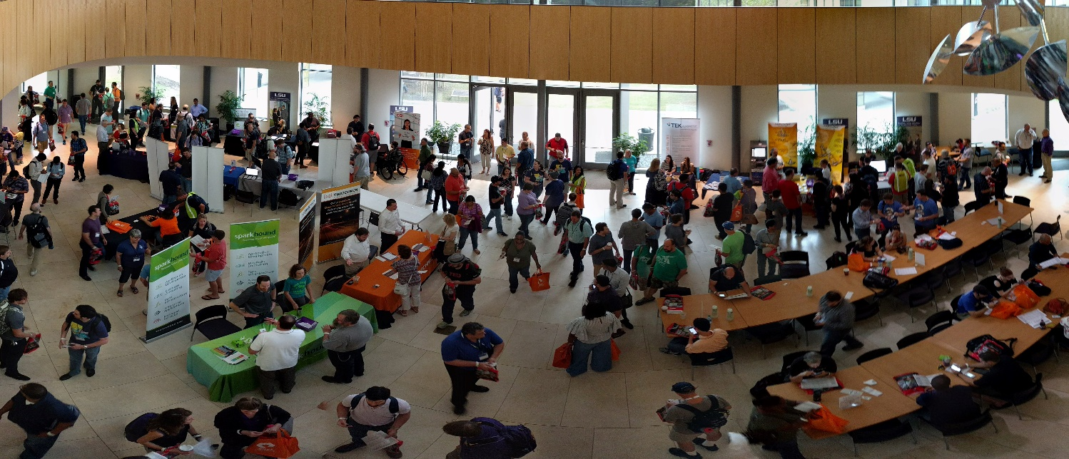
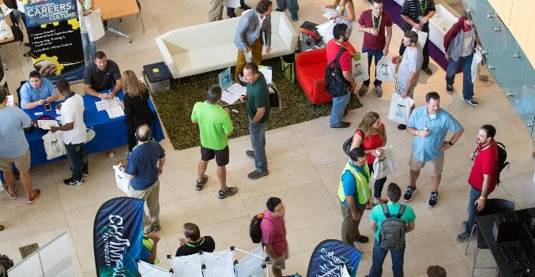
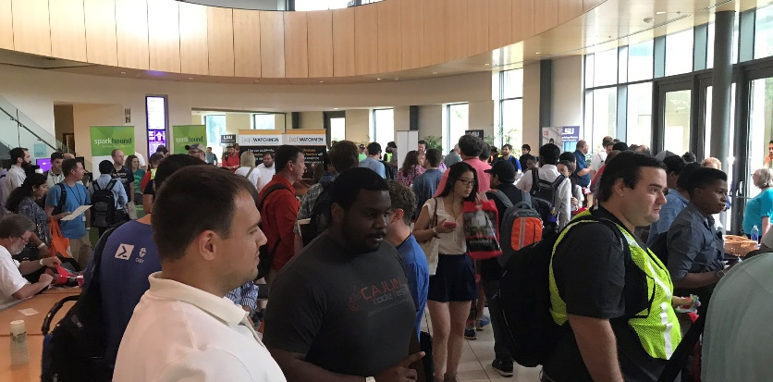
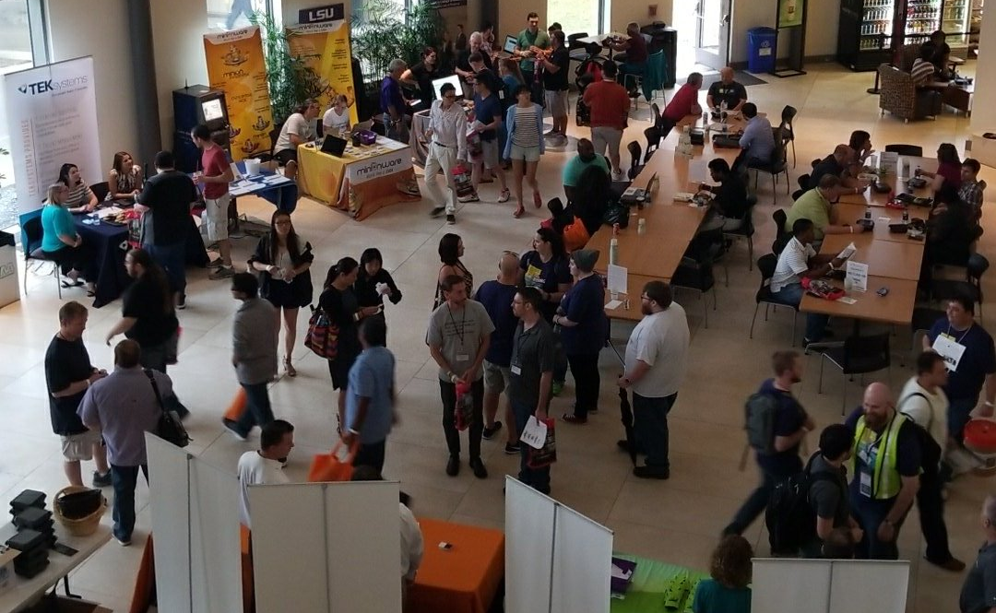
Free SQL Server, .NET, Business Intelligence training and more!
An all day FREE training event with SQL Server and Development related sessions spread out over multiple tracks of Business Intelligence, SQL Development,
Database Administration, IT Pro, .NET,
Career Development, and CIO/IT Management
See you August 11 at
SQLSatBR.com

Slide 78
Bio and contact
William D Assaf, MCSE
Baton Rouge SQL Server UG board and SQLSaturday chair
Principal Consultant, Manager – DBA Team at
Sparkhound Inc. in Baton Rouge
William.Assaf@sparkhound.com
Twitter: @william_a_dba
This presentation, including all source code and this slide deck, has been posted at my blog:
SQLTact.com

